Slide 1
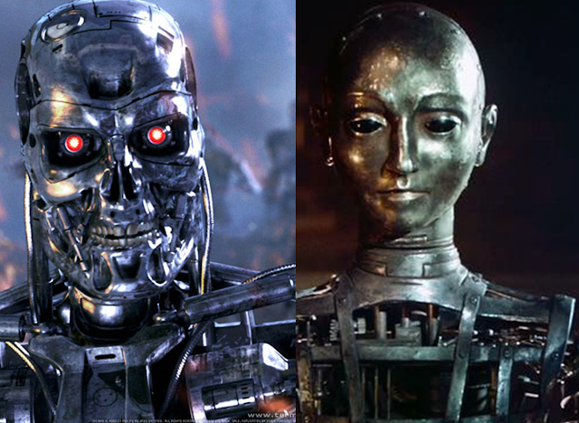
Theory Of Automata
1
Notes:
<number>

Slide 2
Lecture # …
Theory of Automata
2

Slide 3
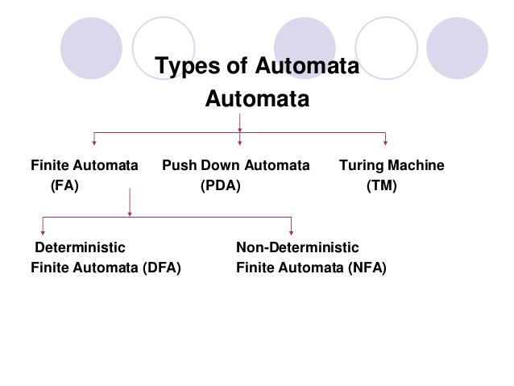
2

Slide 4
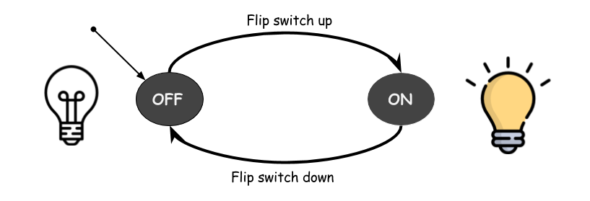
FINITE AUTOMATA
4

Slide 5
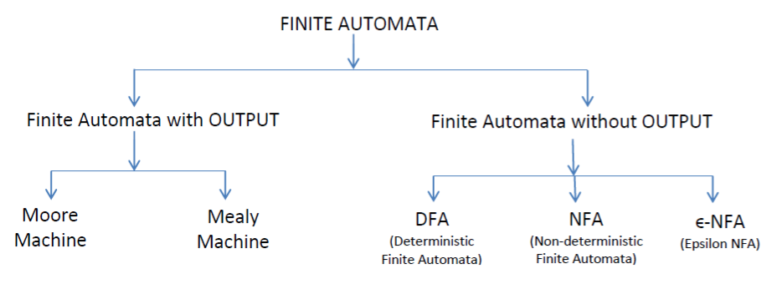
Types of Finite Automata
4

Slide 6
FINITE AUTOMATA WITH OUTPUT

Slide 7
Finite Automata with Output
* Finite automata have a limited capability of either accepting a string or rejecting a string.
*Acceptance of a string was based on the reachability of a machine from starting state to final state.
* Finite automata can also be used as an output device.
4

Slide 8
* A finite automata with output is similar to finite automata (FA) except that ,
the additional capability of producing output.
*In a formal way it is also known as Finite State Machine (FSM) or Transducer
“FSM = Transducer = Finite automata with output = Finite automata + Output Capability”
4

Slide 9
Characteristics of FSM with Output:
* Finite automata with output machines do not have final state/states.
*Machine generates an output on every input.
*The value of the output is a function of current state and the current input.
*Finite automata with output machines are characterized by two behaviors;
1:State transition function (δ)/ STF
2:Output function (λ) /machine function (MAF)
4

Slide 10
Types of FA with Output
There are two types of finite automata with output:
1: Mealy machine: Output is associated with transition.
λ: Σ × Q → O/∆
Set of output alphabet O can be different from the set of input alphabet Σ.
2: Moore machine: Output is associated with state.
λ: Q → O/∆

Slide 11
FA with output consists of 6 tuples
{Q, ∑, q, ∆, δ,λ}.
Q : finite non-empty set of states.
∑ : finite non-empty set of the input alphabet
q : Initial state. ( which may be fixed or variable depends on machine behavior)
∆ : set of output alphabets.
δ : Transition Function ,Q x ∑ -->Q.
λ : Output function , Q → ∆
4

Slide 12
1: Mealy Machine
*A mealy machine is defined as a machine, whose output values are determined by both its current state and current inputs.
*It can be described by a 6 tuple (Q, ∑, ∆, δ, q0, λ)

Slide 13
1: Mealy Machine
Q: finite set of states.
∑: finite set of symbols called the input alphabet.
∆/O: finite set of symbols called the output alphabet.
δ:input transition function where δ: Q × ∑ → Q λ: output transition function( Q × ∑ → ∆/O)
q0:initial state from where any input is processed (q0 ∈ Q)

Slide 14
Q = {q0 , q1}
∑ = {0,1}
∆ = {a,b}
q0={q0}
δ: Q × ∑ → Q
λ: Q × ∑ → ∆
0/a
0/b 1/a
1/b
Note : Length of input string = Length of output string
q0
q1
4

Slide 15
Transition Table
 |  | Next State
Present State | Input | = 0 | Input | = 1
 | State | Output | State | Output
→ q0 | q1 | a | q0 | b
q1 | q0 | b | q1 | a
15

Slide 16
Examples
1: Construct a Mealy Machine that produces 1’s complement of any binary input string.
16

Slide 17
2: Construct a Mealy Machine that prints ‘a’ whenever sequence 01 is encountered in any binary input string.
17

Slide 18
3: Design a Mealy Machine accepting language consisting of strings from where = {a,b} the should either end with ‘aa’ or ‘bb’
18

Slide 19

Don’t forget to draw Transition Table and mention 6 tuples for the all of these examples.
18

